Slide 1
Stay in touch
Check your school gmail for information from your teachers

Slide 2
Google classroom
Check your school g-mail for important information from your teachers.
Teachers will send their class code so that you can log in to google classroom and join a class.
Teachers will use google classroom to communicate information for daily lessons.

Slide 3
Accessing Google Classroom
Option #1
Go to Hobbs School website.
Click Students
Click Google Apps
Choose Classroom.
Choose the + option.
Click Join class
Enter Class code and click join.
Option #2
Go to Hobbs School website.
Click Students
Click Google Apps
Go to Gmail.
Look for email from your teacher.
Click the blue join button.

Slide 4
On-line Class Times
Check your school g-mail daily for invitations from your teachers for class meeting times and platforms (Zoom, Google Hangouts, Google Meets, etc).

Slide 5
Remind 101
Check your school g-mail for remind code from your teacher.
Teachers will be able to send text messages to you in order to communicate time sensitive information.

Slide 6
edgenuity
Most classes will utilize edgenuity throughout this school year. Some classes are not available in Edgenuity. If your class is not available through Edgenuity, you will receive information from your teacher about how to access the class.
Edgenuity is your classroom for remote (hybrid) or HOLA.

Slide 7
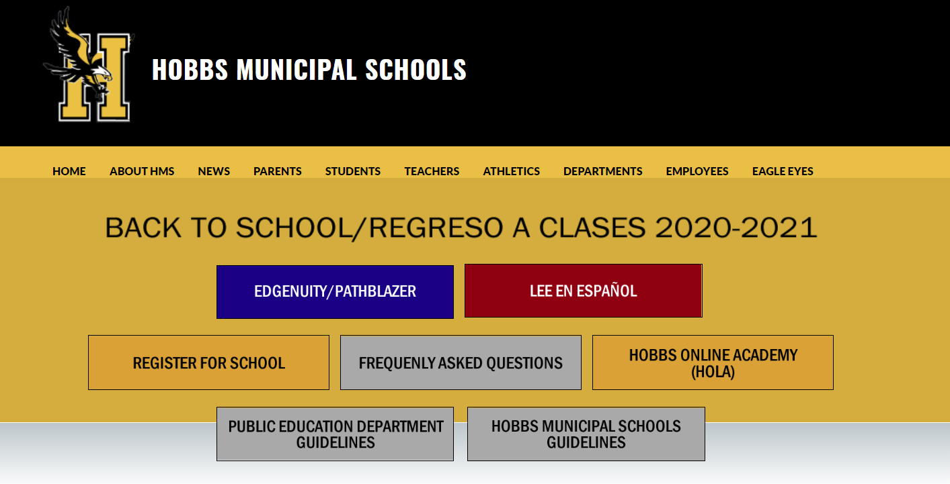
Edgenuity Access

Slide 8
Assignment #4
1. Contact each of your teachers through g-mail.
2. Join your Google classrooms.
3. join remind 101.
Remember- All assignments are due by Monday, August 17

